Slide 1
Hardware Specifications
Group 4
Varundeep Singh
C0754247

Slide 2
List of components -
Piezo Buzzer
Relay
Bulb
Proximity IR Sensor
16 x 2 LCD Display
DC Voltage Regulator
Li-ion battery
Battery Charger
Beaglebone Black
Wi-fi Module
Connecting Wires
Arduino Uno
Bluetooth Module

Slide 3
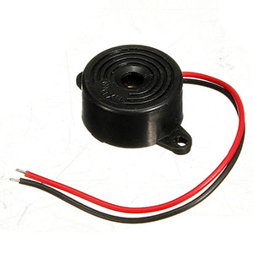
Piezo Buzzer -
This buzzer is used to give an alert sound when an over-speeding vehicle passes by the sensors.
Piezo buzzers are like tiny little speakers, but unlike speakers they don't require an amplifier or other complex circuitry to drive them.
When voltage is applied to the piezo it grows and shrinks in size, and by changing the voltage over time you can make the piezo change shape fast enough to create a pressure wave that your ears interpret as sound.

Slide 4
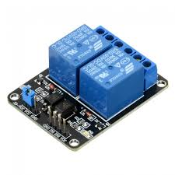
Relay -
A relay is used to connect the bulb to our Beaglebone Black and Li-ion battery.
This relay will act as a switch to control the bulb.

Slide 5
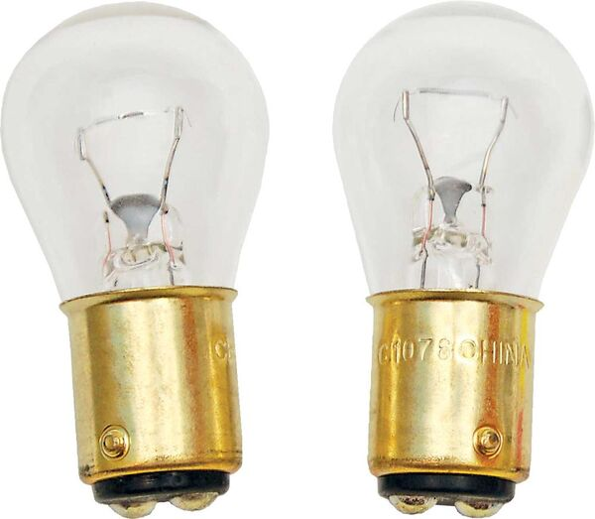
Bulb -
The bulb is used along with the buzzer to create alert notifications.
We will be using a 12V bulb in our setup.
This bulb needs a relay to connect to the Beaglebone Black.

Slide 6
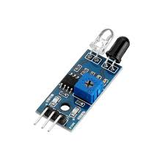
Proximity IR Sensor -
These sensors will be used to detect the over-speeding vehicles.
The method in which these sensors will work is that 2 sensors will be kept at a distance from each other.
In an ideal situation, at a certain prescribed speed limit, a car will cover the distance between the sensors in ’t’ seconds.
If the car takes any time less than ‘t’ seconds, it means that the car was over-speeding.
This is how we will be able to detect our over-speeding vehicles.

Slide 7
Features -
Proximity sensors detect an object without touching it, and they therefore do not cause abrasion or damage to the object.
They are suitable for use in locations where water or oil is used.
They provide high-speed response, compared with switches that require physical contact.
They can be used in temperatures ranging from -40 to 200°C.
They detect the physical changes of an object, so they are almost completely unaffected by the object’s surface colour.

Slide 8
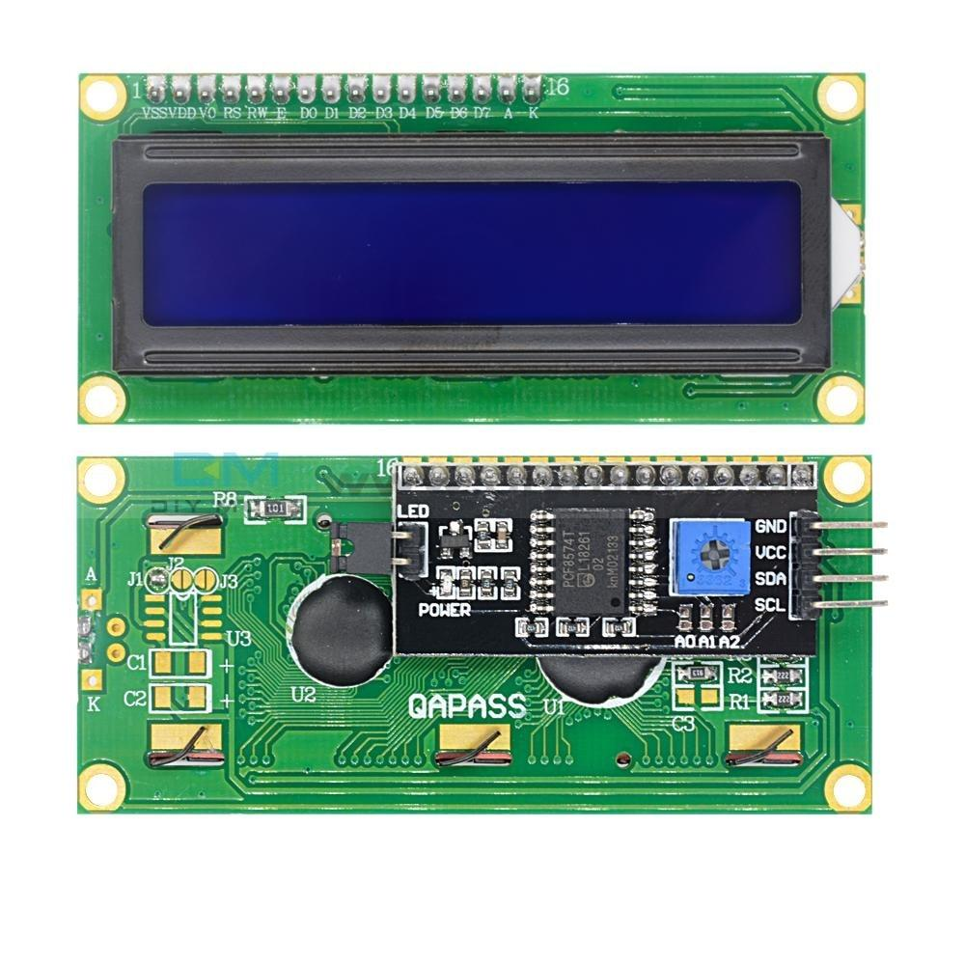
16 x 2 LCD Display -
This display will the show the speeds of the vehicles passing by.
Operating voltage: 4.7 V – 5.3V
Current consumption is 1mA without backlight
Alphanumeric LCD display module, meaning can display alphabets and numbers

Slide 9
Features -
Consists of two rows and each row can print 16 characters.
Each character is built by a 5 x 8 pixel box.
Can work on both 8-bit and 4-bit mode.
It can also display any custom generated characters.
Available in Green and Blue Backlight.

Slide 10
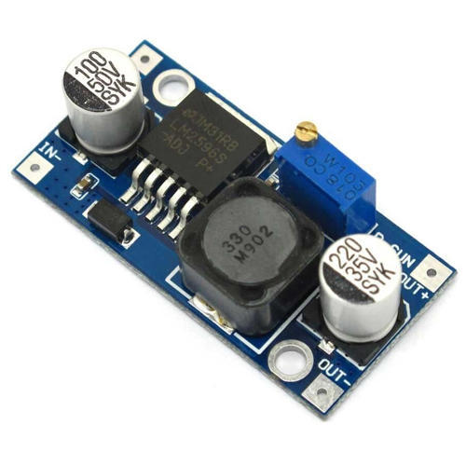
DC Voltage Regulator -
A DC voltage regulator is used to power the Beaglebone Black from the Li-ion battery.
We will be using an LM2596 DC voltage regulator in our project.

Slide 11
Features -
Adjustable version output voltage range: 1.2-V to 37-V ±4% maximum over line and load conditions.
3-A output load current.
Input voltage range up to 40 V.
High efficiency.
Requires only four external components
Excellent line and load regulation specifications

Slide 12
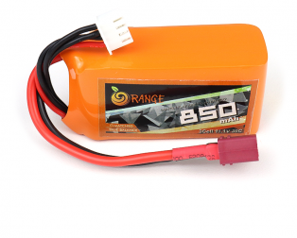
Li-ion battery -
Li-ion battery is the best option to power a portable project.
Today, lithium-ion is the fastest growing and most promising battery chemistry.

Slide 13
Features -
High energy density - potential for yet higher capacities.
Does not need prolonged priming when new. One regular charge is all that's needed.
Relatively low self-discharge - self-discharge is less than half that of nickel-based batteries.
Low Maintenance - no periodic discharge is needed; there is no memory.
Specialty cells can provide very high current to applications such as power tools.

Slide 14
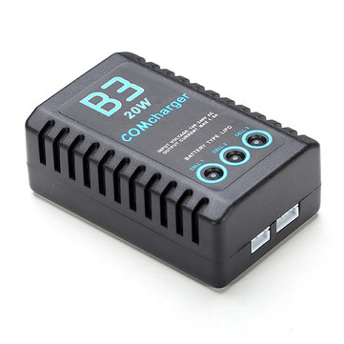
Li-ion battery charger -
The Li-ion batteries need to be charged at some point.
This charger comes into play at that time.

Slide 15
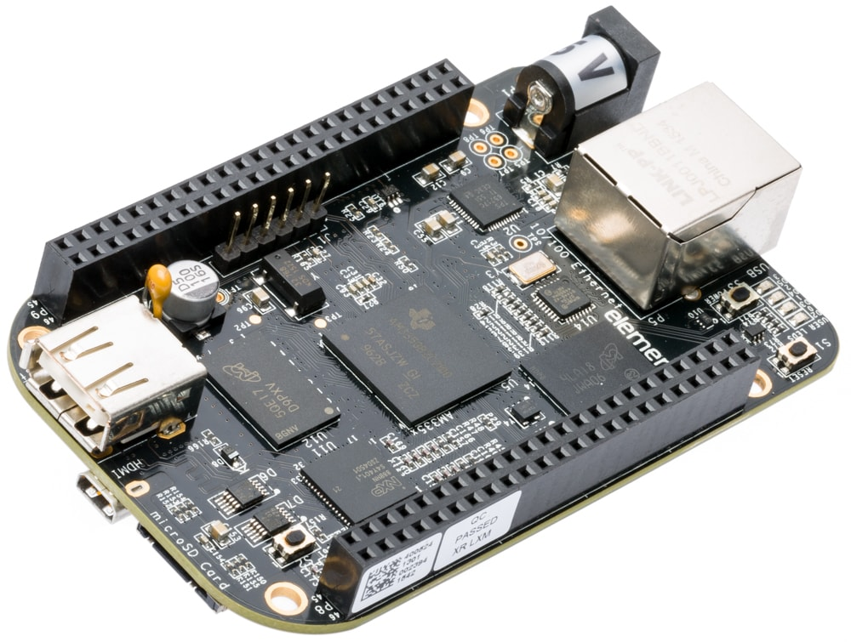
Beaglebone Black -

Slide 16
Features -
BBB is our main microcontroller unit.
It is a low-cost, community-supported development platform for developers and hobbyists.
Boot Linux in under 10 seconds and get started on development in less than 5 minutes with just a single USB cable.

Slide 17
Processor -
AM335x 1GHz ARM Cortex-A8.
512MB DDR3 RAM.
4GB 8-bit eMMC on-board flash storage.
3D graphics accelerator.
NEON floating-point accelerator.
2x PRU 32-bit microcontrollers.

Slide 18
Software Compatibility -
Debian.
Android.
Ubuntu.
Cloud9 IDE on Node.js w/ BoneScript library.

Slide 19
Connectivity -
USB client for power & communications.
USB host.
Ethernet.
HDMI.
2x 46 pin headers.

Slide 20
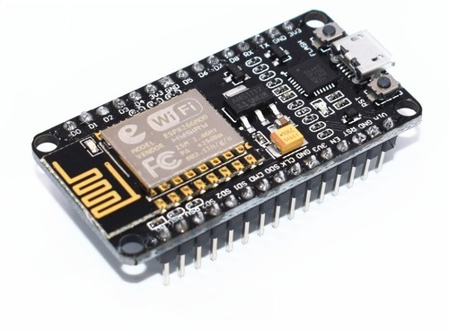
Wi-fi Module -
We are making an IoT based project.
So, it requires internet connectivity.
As Beaglebone Black does not have an inbuilt Wi-fi module, we are using and external module.
We are using ESP8266 in our project.

Slide 21
Features -
High Durability - ESP8266EX is capable of functioning consistently in industrial environments, due to its wide operating temperature range. With highly-integrated on-chip features and minimal external discrete component count, the chip offers reliability, compactness and robustness.
Compactness - ESP8266EX is integrated with a 32-bit Tensilica processor, standard digital peripheral interfaces, antenna switches, RF balun, power amplifier, low noise receive amplifier, filters and power management modules. All of them are included in one small package, our ESP8266EX.
Power-saving Architecture - Engineered for mobile devices, wearable electronics and IoT applications, ESP8266EX achieves low power consumption with a combination of several proprietary technologies. The power-saving architecture features three modes of operation: active mode, sleep mode and deep sleep mode. This allows battery-powered designs to run longer.
32-bit Tensilica Processor - The ESP8266EX microcontroller integrates a Tensilica L106 32-bit RISC processor, which achieves extra-low power consumption and reaches a maximum clock speed of 160 MHz. The Real-Time Operating System (RTOS) and Wi-Fi stack allow about 80% of the processing power to be available for user application programming and development.

Slide 22
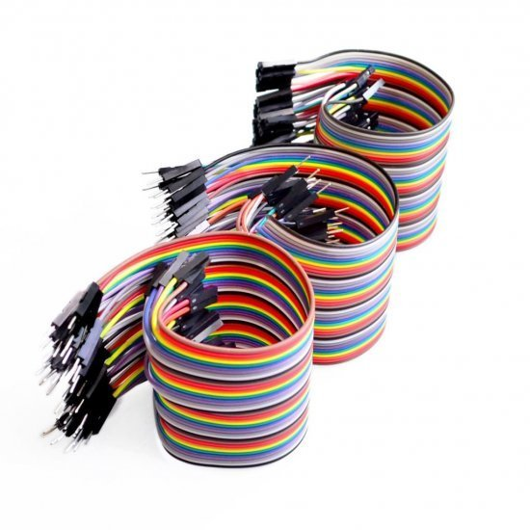
Connecting wires -
We are using these wires to connect the components to each other.
They provide a medium to an electrical current so that they can travel from one point on a circuit to another.
These wires are made of copper or aluminum, because copper is cheap and electrically conductive.

Slide 23
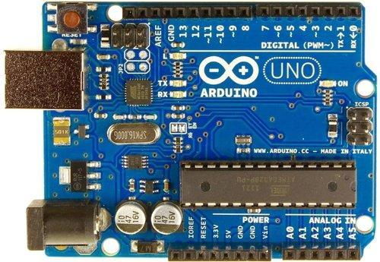
Arduino Uno -
Arduino Uno is the slave device in our system.
It is a microcontroller based on the ATmega328P.

Slide 24
Features -
Operating voltage: 5V
Digital I/O pins: 14
Flash memory: 32 kB of which 0.5 kB used by bootloader
SRAM: 2 kB
EEPROM: 1 kB
Clock speed: 16 MHz
DC per I/O pin: 20mA

Slide 25
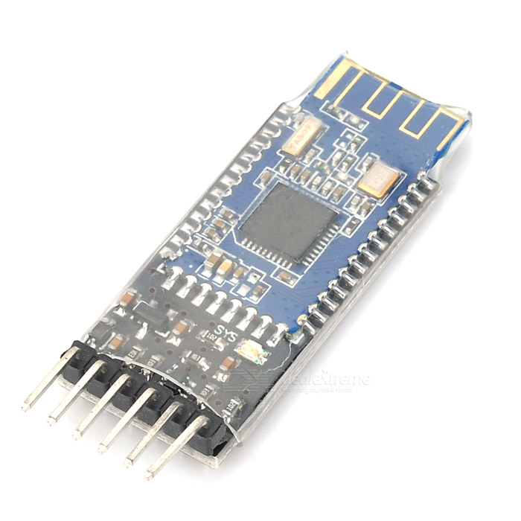
Bluetooth Module -
We are using a Bluetooth module to establish a connection between the Beglebone Black and the Arduino Uno.
We are using HM-10 module for this purpose.

Slide 26
Features -
BT Version: Bluetooth Specification V4.0
Long range: Open space have 100 Meters
Operating voltage: 2.0V – 3.6V
Operating temperature: -40ºC to +85ºC
In-System-Programmable Flash: 128 KB or 256KB
8-KB SRAM
Portable size

Slide 27
References -
Arduino Uno Rev3. (n.d). Retrieved from https://store.arduino.cc/usa/arduino-uno-rev3
Beaglebone Black. (n.d). Retrieved from https://beagleboard.org/black
DiCola, T. (2020, October 12). Using Piezo Buzzers with CircuitPython and Arduino. Retrieved from https://learn.adafruit.com/using-piezo-buzzers-with-circuitpython-arduino/hardware
ESP8266. (n.d). Retrieved from https://www.espressif.com/en/products/socs/esp8266
HM-10 Bluetooth Module. (2018, September 25). Retrieved from https://components101.com/wireless/hm-10-bluetooth-module
Is Lithium-ion the ideal battery? (n.d). Retrieved from https://batteryuniversity.com/learn/archive/is_lithium_ion_the_ideal_battery
LM2596. (n.d). Retrieved from https://www.ti.com/product/LM2596#product-details##features
Proximity Sensors. (n.d). Retrieved from http://www.ia.omron.com/support/guide/41/introduction.html
The function of Connecting Wires. (2016, November 17). Retrieved from http://epcb2016.blogspot.com/2016/11/the-function-of-connecting-wires.html
16 x 2 LCD Module. (2017, August 30). Retrieved from https://components101.com/16x2-lcd-pinout-datasheet

